Slide 1

INHERITANCE

Slide 2
Inheritance In Python
Inheritance is the capability of one class to derive or inherit the properties from another class and use it whenever needed.
The benefits of inheritance are:
It represents real-world relationships well.
It provides reusability of a code. We don’t have to write the same code again and again. Also, it allows us to add more features to a class without modifying it.
It is transitive in nature, which means that if class B inherits from another class A, then all the subclasses of B would automatically inherit from class A.

Slide 3
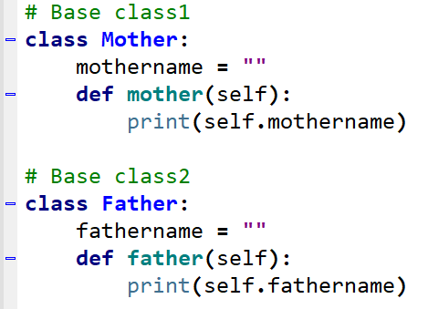
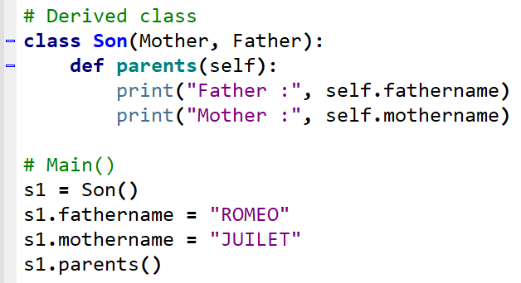


Slide 4
PARENT / BASE CLASS CHILD / DERIVED CLASS
object is root of all classes
Different forms of Inheritance: 1. Single Inheritance: When a child class inherits from only one parent class 2. Multiple inheritance: When a child class inherits from multiple parent classes
Unlike Java and like C++, Python supports multiple inheritance. We specify all parent classes as a comma-separated list in the bracket.

Slide 5
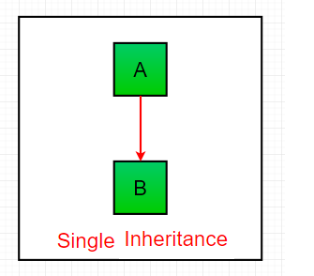
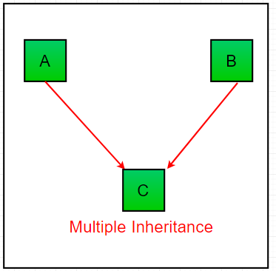
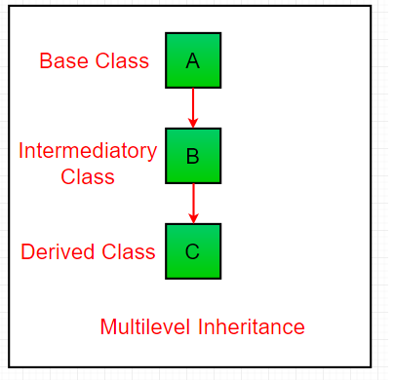
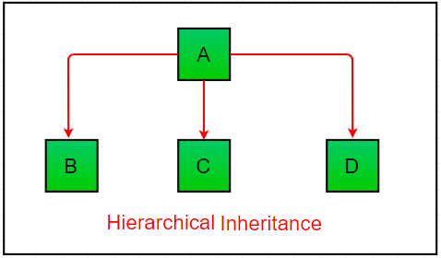

Slide 6
TYPES
3. Multilevel inheritance: When we have a child and grandchild relationship.
4. Hierarchical inheritance More than one derived classes are created from a single base. 5. Hybrid inheritance: This form combines more than one form of inheritance.
Basically, it is a blend of more than one type of inheritance.

Slide 7
Private Members Of Parent Class
We don’t always want the instance variables of the parent class to be inherited by the child class
i.e. we can make some of the instance variables of the parent class private,
which won’t be available to the child class.
We can make an instance variable by adding double underscores before its name.

Slide 8

CODING IS FUN ! THANK YOU !!

